Slide 1
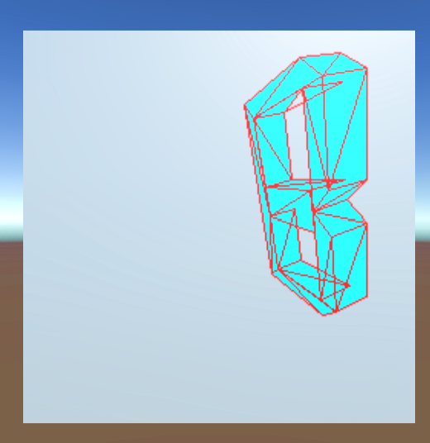
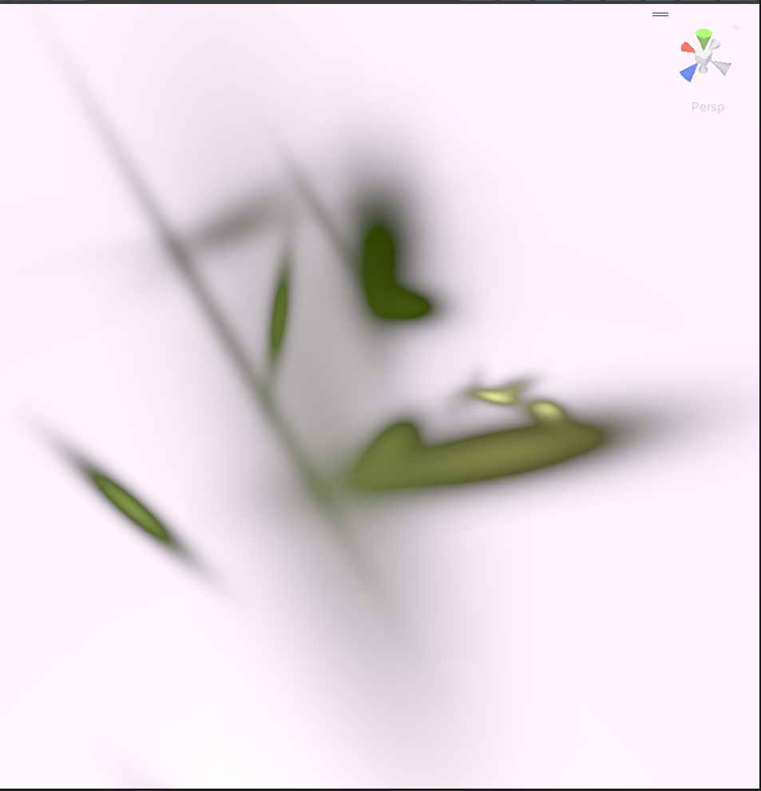
Billy Elsbury T00224562
Capturing, Editing and Merging Gaussian Splats to Create Novel 3D Environments
Traditional Geometry
Zoomed in Splats

Slide 2
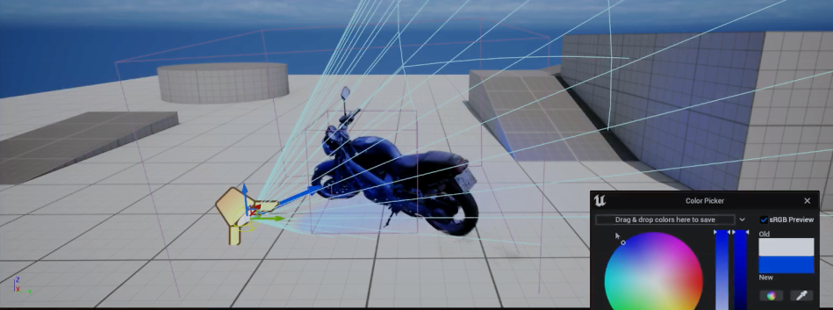
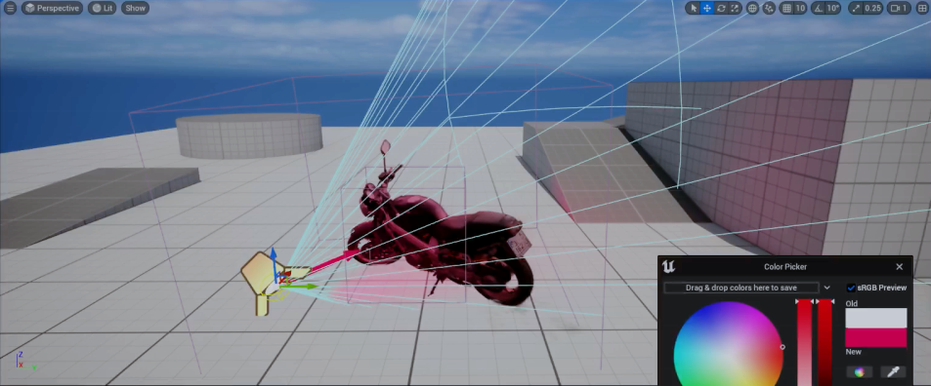
What is done ?
More videos captured with DJI Osmo Pocket 3 from ACE.
Created Splats using new videos.
Splats imported into Unreal Engine 5 where they can be lit dynamically. This implementation uses UE’s Niagara particle system.
Progress made towards editing individual Splat properties in Unity.

Slide 3
What is left to do.
Finalise Unity editing tools to allow for individual Splat attributes to be edited. i.e. colour, size, transparency.
Compare Unity and Unreal Engine. Performance Culling Collisions etc.
Overcome lack of collisions with Gaussian Splats.

Slide 4
Issues/Concerns
I will not be able to edit individual Splats in Unity to a satisfactory level.
Collisions may not be feasible, in which case Gaussian Splat use case for games is limited.
The direction of the project may lose focus.

